Slide 1
IPE Curriculum: Sharing Strategies for Mapping
January 25, 2024
CIHC Community of Practice
Moni Fricke, BMR(PT), PhD
Director, Office of Interprofessional Collaboration
University of Manitoba
Sarah Wilkinson, RKin, PhD
Program Coordinator- IPE
Humber College
Recording in progress

Slide 2
Learning Objectives
By the end of this session, participants will be able to:
Explore the benefits of engaging in IPE curriculum mapping;
Discuss methods for IPE curriculum mapping;
Reflect on the application of IPE curriculum mapping to their own context.
Notes:
Session Description:
Curriculum maps provide representation of all parts of a curriculum pathway (Joyner, 2016). Such maps can facilitate alignment between the operational and the planned curriculum and can make transparent what, how and when it is taught and how the content is assessed (Plaza et al. 2007; Harden, 2001). A curriculum map that is pragmatic and collaborative in its development and implementation is an effective strategy to iteratively evaluate and evolve existing curriculum. Furthermore, curriculum mapping can be utilized for efficient and effective reporting on interprofessional education (IPE) activities as part of accreditation requirements for health professional education programs. This interactive presentation will present two examples of “living” curriculum mapping processes from two Canadian educational institutions, one university and one college, to spark discussion and reflection amongst participants. Participants will be invited to share their own experiences with IPE curriculum mapping.
Learning Objectives:
By the end of this session, participants will be able to:
Explore the benefits of engaging in IPE curriculum mapping;
Discuss methods for IPE curriculum mapping;
Reflect on the application of IPE curriculum mapping to their own context.
References:
Harden, R.M. (2001) AMEE Guide No. 21: Curriculum mapping: a tool for transparent and authentic teaching and learning, Medical Teacher 23(2): 123-137 doi: 10.1080/01421590120036547
Joyner, H.S. (2016). Curriculum Mapping: A Method to Assess and Refine Undergraduate Degree Programs. Journal of Food Sciences Education 15(3): 83-100.
Plaza, D. (2007). Curriculum Mapping in Program Assessment and Evaluation. American Journal of Pharmaceutical Education 71(2): 20–20, doi:10.5688/aj710220.
It can contribute to accreditation processes in a meaningful, authentic, and responsive way while facilitating communication processes and reducing duplication of work efforts. It can also provide a valuable resource for collaborating on shared curriculum across programs.
The development of an iterative “living” curriculum mapping process demonstrates the benefits of collaborating on the delivery and evaluation of a shared curriculum across health professional programs. Learning objectives, strategies and domains, competency targets, educational outcomes, assessments, evaluation, and accreditation standards are tracked in this innovative user-friendly method that is transferrable to other complex longitudinal curricula shared across curricula.

Slide 3
Session Outline
Welcome and introductions (5 mins)
Background of curriculum mapping (5 mins)
Example # 1 – Humber College (15 mins)
Example #2 – Uni of Manitoba (15 mins)
Discussion
Does anyone have their own example they wish to share
What challenges have you faced with curriculum mapping and how have you addressed them (or not)?
Wrap-up

Slide 4
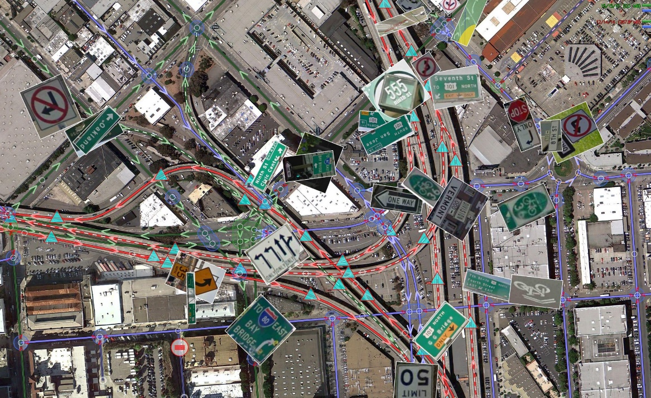
Curriculum Mapping
© Creative Commons

Slide 5
Curriculum mapping
provides representation of all parts of a curriculum pathway (Joyner, 2016)
can facilitate alignment between the operational and the planned curriculum (Joyner, 2016)
can make transparent what, how and when it is taught and how the content is assessed (Plaza et al. 2007; Harden, 2001)

Slide 6
IPE Accreditation Requirements
Azzam, M., Puvirajah, A., Girard, MA. et al. Interprofessional education-relevant accreditation standards in Canada: a comparative document analysis. Hum Resour Health 19, 66 (2021). https://doi.org/10.1186/s12960-021-00611-1

Slide 7
AIPHE FinalEnglishMay6th.qxd6 (casn.ca)
https://peac-aepc.ca/pdfs/Resources/Competency%20Profiles/AIPHE%20Interprofessional%20Health%20Education%20Accreditation%20Standards%20Guide_EN.pdf
Grymonpre, R.E., Bainbridge, L., Nasmith, L. et al. Development of accreditation standards for interprofessional education: a Canadian Case Study. Hum Resour Health 19, 12 (2021). https://doi.org/10.1186/s12960-020-00551-2
IPE Accreditation Standards

Slide 8
AIHPE Accreditation standards
Organizational commitment
Faculty/Academic Unit
Students
Educational Program

Slide 9
AIHPE Accreditation standards
Organizational commitment
Faculty/Academic Unit
Students
Educational Program

Slide 10
Example #1
Humber College
Interprofessional Education Program

Slide 11
IPE MAPPING
01
ABOUT HUMBER
02
HISTORY OF IPE
03
STRATEGY
04
PROCESS

Slide 12
BIOMEDICAL SCIENCES & HEALTH REGULATION
INCLUSIVE &
RESPONSIVE EDUCATION
Workplace Health and Wellness
Biomedical Sciences
Infection Prevention & Control
Clinical Research
Clinical Bioinformatics
Health Sector Regulatory Compliance
Regulatory Affairs
Biotechnology
34 Full-Time Programs
~ 8000 Full-Time students
Range of credentials
Inclusive Resource Practice- Child and Family
Early Childhood Education
Community Integration through Co-operative Education
EMERGENCY &
FUNERAL SERVICES
INTEGRATIVE & ALLIED HEALTH
EXERCISE & NUTRTIIONAL SCIENCES
Advanced Care Paramedic
Paramedic
Funeral Director
Fire Services
Pre-Service Firefighter Education & Training
Emergency Telecommunications
Transfer Service Sales Representative
Systems Navigator
Wellness Coaching
Massage Therapy
Traditional Chinese Medicine Practitioner
Occupational Therapist Assistant & Physiotherapist Assistant
Pharmacy Technician
Hearing Instrument Specialist
Exercise Science & Lifestyle Management
Fitness & Health Promotion
Food & Nutrition Management
Nutrition & Healthy Lifestyle Promotion
NURSING & PERSONAL
SUPPORT WORKER
Nursing
Practical Nursing
Personal Support Worker

Slide 13
HISTORY
LARGE EVENTS
RESOURCES LOGISTICS
OUTSIDE OF CURRICULUM

Slide 14
STRATEGY
PROGRAM COORDINATOR FOR IPE
HIRED FALL 2019

Slide 15
STRATEGY
“Go slow to go fast!”
Dr. John Gilbert
Image: CIHC (n.d.) Canadian Interprofessional Health Collaborative Board of Directors https://www.cihc-cpis.com/directors.html

Slide 16
STRATEGY
2019
2020
2021
2023
NEEDS ASSESSMENT
IPE FRAMEWORK DEVELOPMENT
IDEAL FUTURE MAPPING
CURRICULUM MAPPING
Notes:
Change management approach to IPE curriculum integration

Slide 17
NEEDS ASSESSMENT
Past & Current IPE
Faculty IPE KSAs
Principles
Co-Curricular
Curricular
Accreditors
Regulators
Associations
Support of IPE/IPCP
Varied knowledge & experience
Decisions driven by the program
Sustainable
Small, Early, Often
2019

Slide 18
IPE COMPETENCY FRAMEWORK DEVELOPMENT
Co-create shared, scaffolded learning for each competency.
Team of faculty from across the FHSW
2020
2019

Slide 19
IPE COMPETENCY FRAMEWORK
 | Foundational | Developmental | Proficient
Competency A | Learning Outcome Learning Outcome Learning Outcome | Learning Outcome Learning Outcome Learning Outcome | Learning Outcome Learning Outcome
Competency B | Learning Outcome Learning Outcome Learning Outcome | Learning Outcome Learning Outcome Learning Outcome | Learning Outcome Learning Outcome
Competency C | Learning Outcome Learning Outcome Learning Outcome | Learning Outcome Learning Outcome Learning Outcome Learning Outcome | Learning Outcome Learning Outcome Learning Outcome
Competency D | Learning Outcome Learning Outcome Learning Outcome | Learning Outcome Learning Outcome Learning Outcome | Learning Outcome Learning Outcome Learning Outcome
Competency E | Learning Outcome Learning Outcome Learning Outcome | Learning Outcome Learning Outcome | Learning Outcome Learning Outcome Learning Outcome
2020
2019

Slide 20
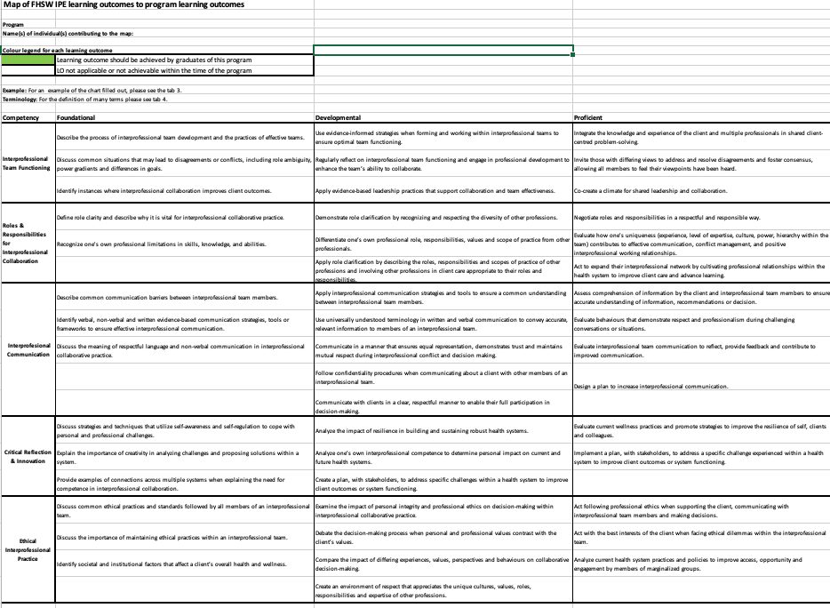
IDEAL FUTURE MAPPING
Foundational
Developmental
Proficient
Competencies
2021
2019
2020
Notes:
PROGRAM PROFILES

Slide 21
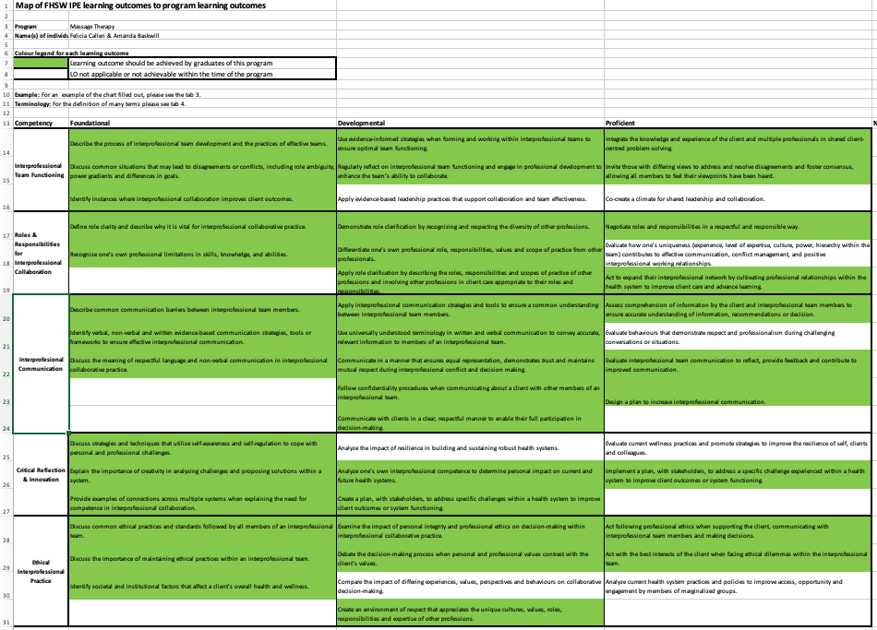
IDEAL FUTURE MAPPING
Foundational
Developmental
Proficient
Competencies
2021
2019
2020

Slide 22
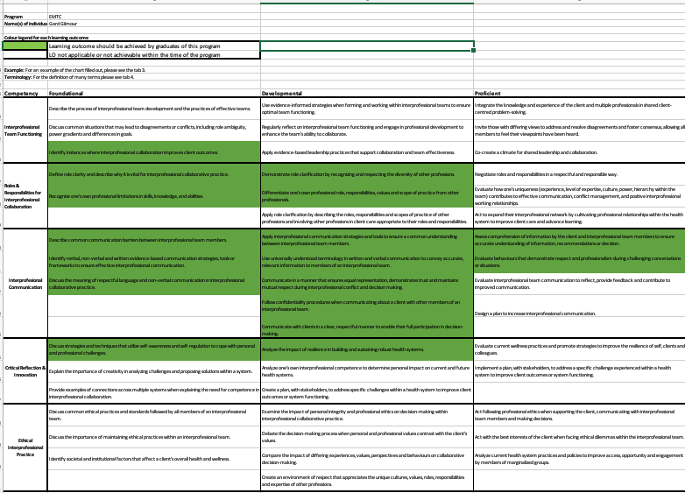
IDEAL FUTURE MAPPING
Foundational
Developmental
Proficient
Competencies
2021
2019
2020

Slide 23
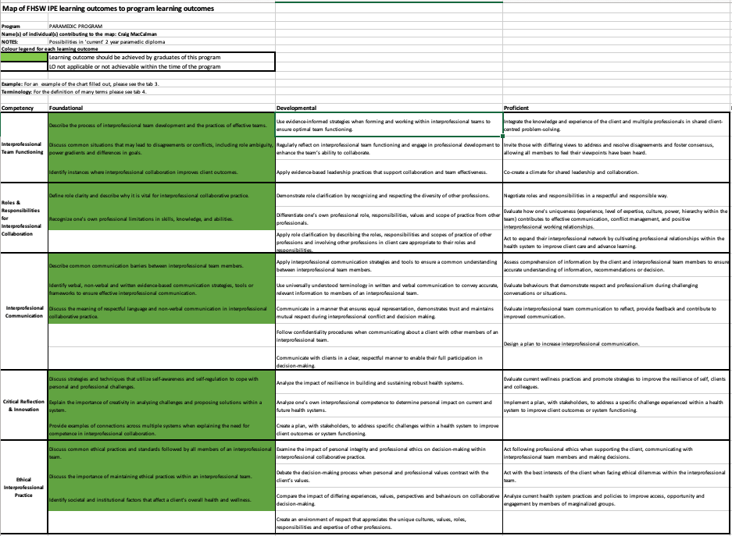
IDEAL FUTURE MAPPING
Foundational
Developmental
Proficient
Competencies
2021
2019
2020

Slide 24
IPE DELIVERY MODEL
IPE 101
Foundational IPE Learning Activities
Centrally developed & delivered
SPECIAL PROJECTS
IPE developed by faculty teams
Centrally supported
Open Access
Integrated
Open Access
Integrated
2020
2023
2019
Notes:
IPE 101 – centrally developed for student to have a baseline KSA for IPCP –
Meets competencies at foundational level

Slide 25
CURRICULUM MAPPING
Identify IPE in curriculum
Identify IPE outside of curriculum
Reflect on its integration into curriculum
Reflect on current gaps vs. ideal future
Geneviève Mailloux
2023
2019
2020
2021

Slide 26
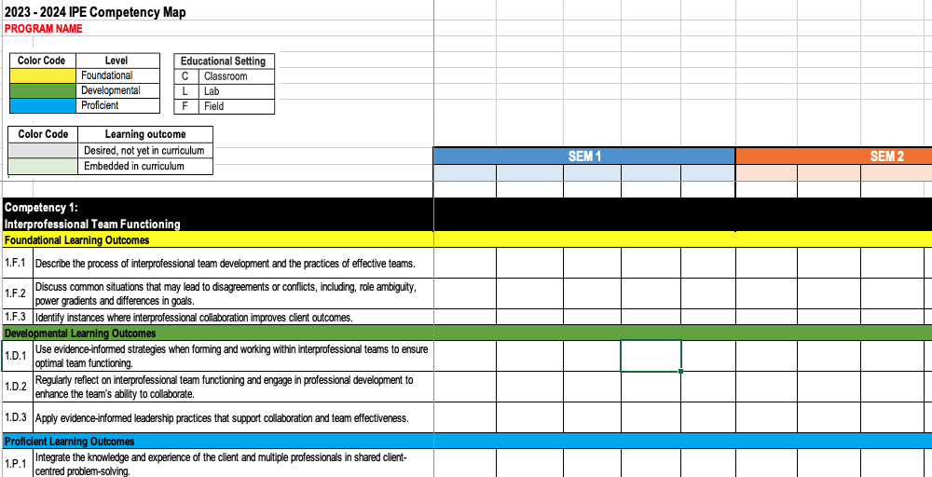
CURRICULUM MAPPING
Identify IPE in curriculum
Identify IPE outside of curriculum
Reflect on its integration into curriculum
Reflect on current gaps vs. ideal future
2023
2019
2020
2021

Slide 27
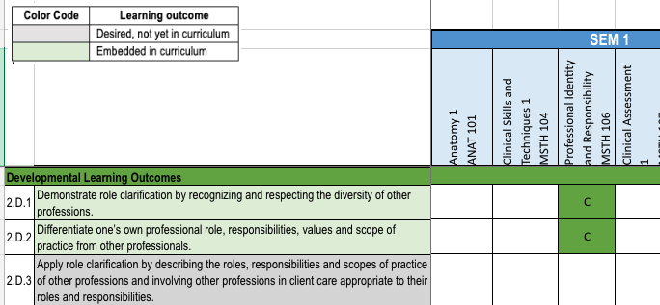
CURRICULUM MAPPING
Identify IPE in curriculum
Identify IPE outside of curriculum
Reflect on its integration into curriculum
Reflect on current gaps vs. ideal future
2023
2019
2020
2021

Slide 28
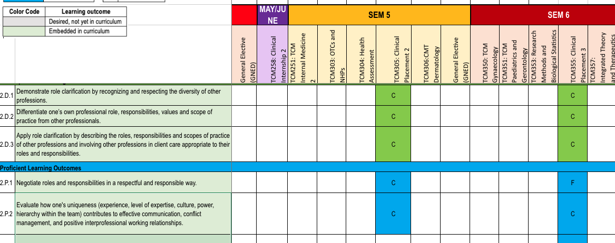
CURRICULUM MAPPING
Identify IPE in curriculum
Identify IPE outside of curriculum
Reflect on its integration into curriculum
Reflect on current gaps vs. ideal future
2023
2019
2020
2021

Slide 29
CURRICULUM MAPPING
Identify IPE in curriculum
Identify IPE outside of curriculum
Reflect on its integration into curriculum
Reflect on current gaps vs. ideal future
2023
2019
2020
2021

Slide 30
CURRICULUM MAPPING
Identify IPE in curriculum
Identify IPE outside of curriculum
Reflect on its integration into curriculum
Reflect on current gaps vs. ideal future
2023
2019
2020
2021

Slide 31
CURRICULUM MAPPING
Identify IPE in curriculum
Identify IPE outside of curriculum
Reflect on its integration into curriculum
Reflect on current gaps vs. ideal future
2023
2019
2020
2021

Slide 32
STRATEGY
“Go slow to go fast!”
Dr. John Gilbert
Image: CIHC (n.d.) Canadian Interprofessional Health Collaborative Board of Directors https://www.cihc-cpis.com/directors.html

Slide 33
STRATEGY
snowball by Hafiz Nur Lutfianto from the Noun Project (CC BY 3.0)

Slide 34
Example #2
University of Manitoba
Office of Interprofessional Collaboration
Acknowledgements

Slide 35
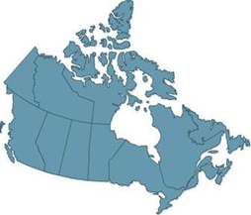
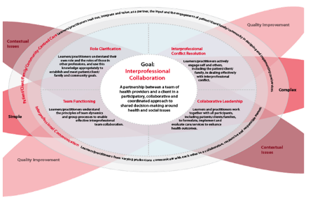
Background of IPE at the University of Manitoba
History of “one-off” opportunities since 2006
OIPC established in 2015
Representatives from 5 Colleges: Dent, Med, Nurs, Pharm, Rehab Sci
10 programs across 4 campuses: Dent, DH, Med, Midwifery, Nurs, OT, PA, Pharm, PT, RT
~635 new students every fall
IPC curriculum
Grounded in 6 competencies for collaboration (CIHC, 2010) & contact theory
Focus on early learners in years 1 & 2 of professional programs
Intended to compliment other IP opportunities
CIHC, 2010
Notes:
Introduction
IPE occurs when two or more professions learn together on an interactive basis to improve collaboration and quality care (Barr et al., 2005)
Growing body of evidence to support interprofessional education (IPE) in achieving IP collaboration (Reeves et al., 2016)

Slide 36
Background of IPE at the University of Manitoba
History of “one-off” opportunities since 2006
OIPC established in 2015
Representatives from 5 Colleges: Dent, Med, Nurs, Pharm, Rehab Sci
10 programs across 4 campuses: Dent, DH, Med, Midwifery, Nurs, OT, PA, Pharm, PT, RT
~635 new students every fall
IPC curriculum
Grounded in 6 competencies for collaboration (CIHC, 2010) & contact theory
Focus on early learners in years 1 & 2 of professional programs
Intended to compliment other IP opportunities
Challenge: How does a faculty keep track of
multiple simultaneous evolving IPE learning opportunities?
CIHC, 2010
Notes:
Introduction
IPE occurs when two or more professions learn together on an interactive basis to improve collaboration and quality care (Barr et al., 2005)
Growing body of evidence to support interprofessional education (IPE) in achieving IP collaboration (Reeves et al., 2016)

Slide 37
Student Enrollment 2016-2023
3,117 will have completed the curriculum by spring 2023

Slide 38
Purpose
To develop a mechanism to track all the IPE activities in the Rady Faculty of Health Sciences, that will meet the needs of IPE educators and accreditation staff alike.

Slide 39
Results should…
Showcase all IPE activities across the faculty
Enable identification of curricular gaps in IPE
Reduce duplication of work
Provide a template for other complex learning activities common across the faculty

Slide 40
IPCC Curriculum Map 1.0
Academic Curriculum
Learning Outcome:
Entry-to-practice level competency
in collaboration
(Collaborative practice-ready)
Clinical/Practice Curriculum
Student-led /Service Learning/Community Outreach
Becoming a Reflective Practitioner

Slide 41
IPCC Curriculum Map 2.0 v1 Program Logic Model

Slide 42
IPCC Curriculum Map 2.0 v2
Term 1 |  |  |  |  |  | Term 2
Year 1 Population Health (N=~630) 9 programs 4 campuses 77 teams | Synchronous Event #1 September | Asynchronous |  |  |  | Synchronous Event #2 January | Asynchronous |  |  |  | Virtual Collaboration Symposium May (voluntary)
 |  | Discussion #1 | Discussion #2 | Discussion #3 | Reflection #1 |  | Discussion #4 | Discussion #5 | Discussion #6 | Reflection #2
Year 2 Patient Safety (N=~570) 9 programs 2 campuses 70 teams | Synchronous Event #3 September | Asynchronous |  |  |  | Synchronous Event #4 January | Asynchronous
 |  | Discussion #7 | Discussion #8 | Discussion #9 | Reflection #3 |  | Discussion #10 | Discussion #11 | Discussion #12 | Reflection #4
IPC Competencies: Team Functioning, IP Communication & Community-Centred Care
IPC Competencies: Role Clarification, Collaborative Leadership & IP Conflict Resolution
Interprofessional Practice Opportunities

Slide 43
Mapping…macro to micro…it’s in the details…
Macro
Micro
Notes:
Big picture and the details within…learning outcomes and learning objectives mapped across the two years…THIS BEING foundational and specific to the OIPC delivered learning activities/experiences.
Still, needed to see how these were seen across the program and HP competencies and or standards—hence, the accreditation IPE mapping project based on the CIHC competencies across the RFHS 9 (10) programs.

Slide 44
OIPC IPE mapping project
Criteria
iterative “living” resource for sharing curriculum across multiple programs
pragmatic and collaborative in its development and implementation
facilitate communication processes, while reducing duplication of work
contribute to accreditation in a meaningful, authentic, and responsive way
provide a template for other complex longitudinal curricula

Slide 45
IPE RFHS mapping development
Partner Consultation
OIPC College leads
Dentistry and Dental Hygiene
Medicine
Pharmacy
Nursing
OIPC Practice Coordinator
IPE Department Leads, College of Rehabilitation Sciences
Faculty-wide Integrated Accreditation Unit
Curriculum mapping expert
© Creative Commons

Slide 46
IPE RFHS mapping development
Considerations
Amount of detail
Embedded links
Filtering options
Accessibility of software (cost and ease of use)
Options
Excel
MS Word
e-LMS
SmartArt

Slide 47
IPE RFHS mapping details
Categories
Learners - year of program, term, course #
Session - title, topic, learning objectives
Collaboration Competency (CIHC, 2010)
Role Clarification
Team Functioning
IP Communication
IP Conflict Resolution
Collaborative Leadership
Patient/Client/Family/ Community-centred Care
Learning Strategy - lecture, tutorial, on-line discussion, simulation, experiential learning
Learning Continuum - novice / beginner, functional, competent, proficient/skilled, expert
© Creative Commons

Slide 48
IPE RFHS mapping details
Categories cont’d
Competency Target (Charles, et al., 2010)
Exposure / Awareness
Immersion / Application
Competence / Integration
Mastery
IPE Educational Outcomes (Adapted by Barr et al., 2000 from Kirkpatrick, 1967)
Level 1: Learners' reaction to experience
Level 2a: Modification of perceptions & attitudes
Level 2b: Acquisition of knowledge & skills
Level 3: Behavioural change
Level 4a: Change in organizational practice
Level 4b: Benefits to patients/clients
© Creative Commons
Notes:
G. Charles, L. Bainbridge, J. Gilbert. The University of British Columbia model of interprofessional education
J Interprof Care, 24 (1) (2010), pp. 9-18
Barr, Hugh & Freeth, D & Hammick, M & Koppel, I & Reeves, Scott. (2000). Evaluations of interprofessional education A United Kingdom review for health and social care. Centre for the Advancement of Interprofessional Education: UK.

Slide 49
IPE RFHS mapping details
Categories cont’d
Learning Domains (Bloom, 1956)
Cognitive (“know”)
Psychomotor (“do”)
Affective (“be”)
Assessment Strategy
Participation Observation
Survey Record of discussion
Reflection Test / exam
OSCE Practice assessment
PIPES Rating (U of T, 2013/2019)
Process (“how”): 4 items
Content (“what”): 4 items
Score of 0, 5 or 10
Red: 30-45 points
Orange: 50 – 60 points
Green: >60 points
© Creative Commons
https://ipe.utoronto.ca/sites/default/files/2019-11-18-PIPEs%20Application%20Form%20-%20final_0.pdf
Notes:
Bloom, B. S.; Engelhart, M. D.; Furst, E. J.; Hill, W. H.; Krathwohl, D. R. (1956). Taxonomy of educational objectives: The classification of educational goals. Handbook I: Cognitive domain. New York: David McKay Company.

Slide 50
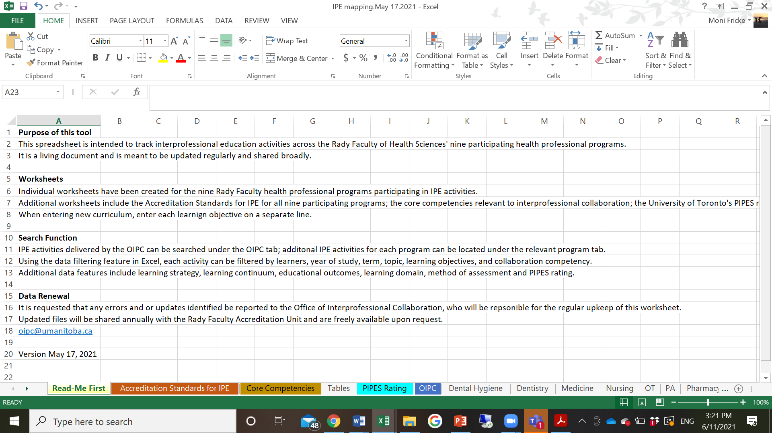
RFHS IPE map
Notes:
Read-me page

Slide 51
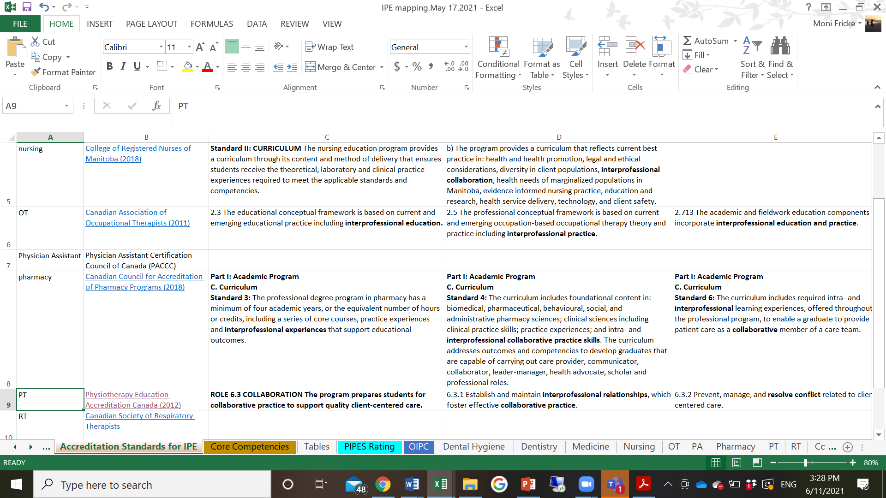
RFHS IPE map
Notes:
Read-me page

Slide 52
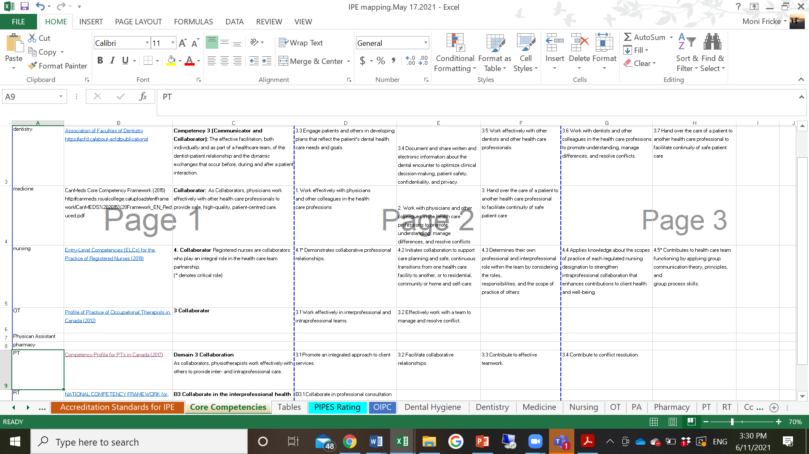
RFHS IPE map
Notes:
Read-me page

Slide 53
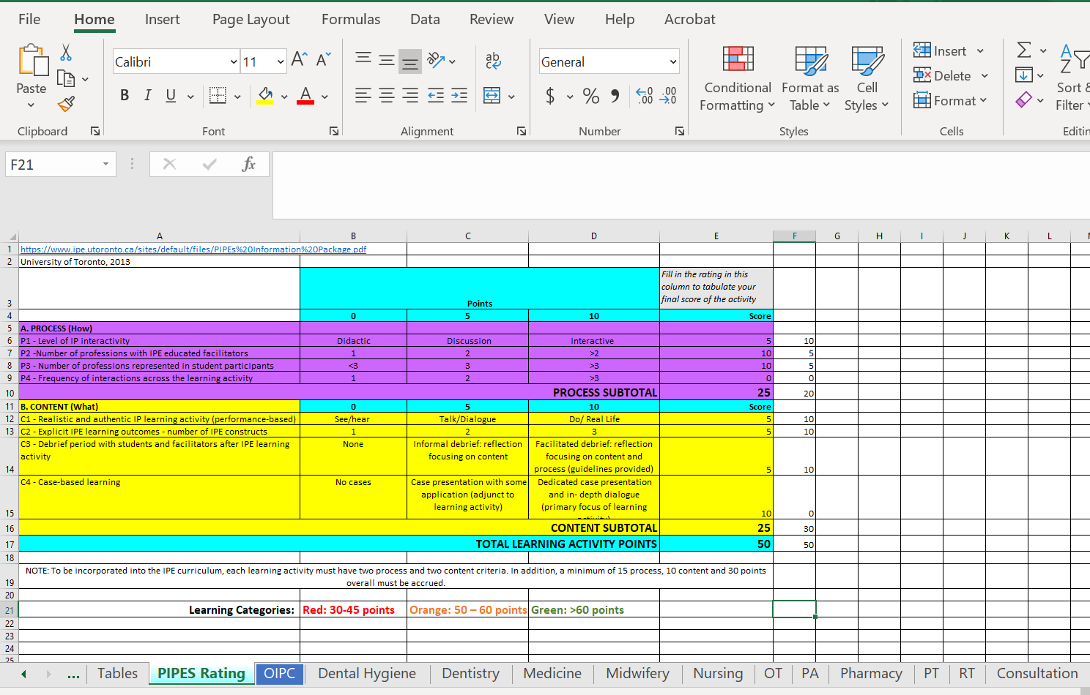
RFHS IPE map
Notes:
Read-me page

Slide 54
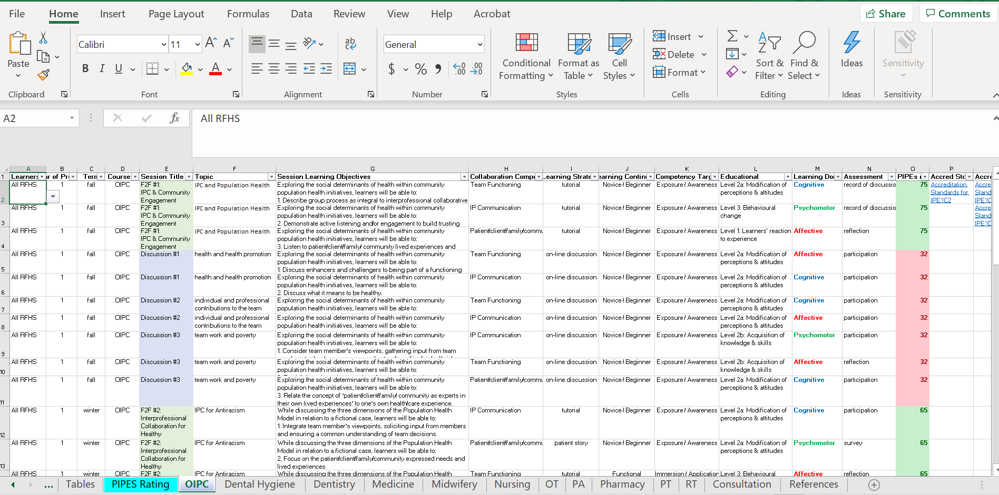
RFHS IPE map
Notes:
Read-me page

Slide 55
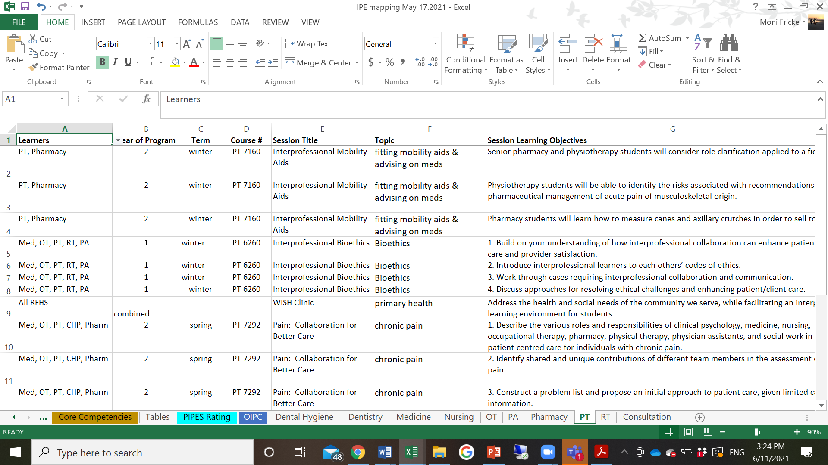
RFHS IPE map
Notes:
Read-me page

Slide 56
Feedback
“This is such a great initiative…The RFHS (Faculty) needs more of these collaborative, free-flow of information tools”.
(Integrated Accreditation Unit)
drop-down menus were easy to use and offered the right amount of detail for accreditation purposes
encouraged the “Read-me” tab
“This is amazing and a very ambitious project!”
(Expert in curriculum mapping)

Slide 57
Conclusion
A faculty-wide common curriculum map is feasible
Challenges of maintenance to be determined
Usability across programs to be determined

Slide 58
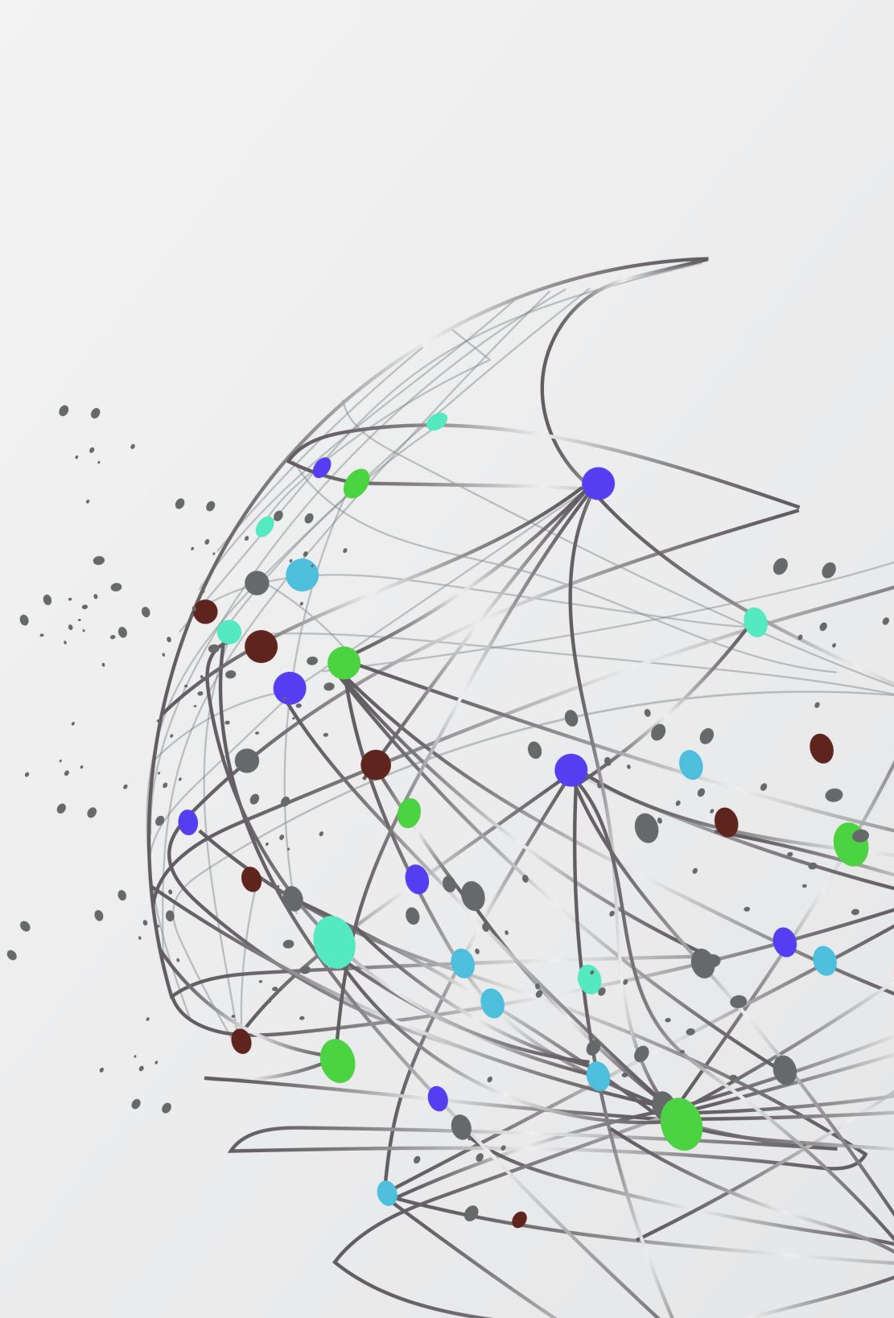
Selected References
Barr, Hugh & Freeth, D & Hammick, M & Koppel, I & Reeves, Scott. (2000). Evaluations of interprofessional education A United Kingdom review for health and social care. Centre for the Advancement of Interprofessional Education: UK.
Canadian Institute for Health Collaboration (2010). National Competency Framework. Author: UBC.
Charles G, Bainbridge L, Gilbert J. (2010). The University of British Columbia model of interprofessional education. J Interprof Care Jan;24(1):9-18. doi: 10.3109/13561820903294549. PMID: 20001544.
Harden, R.M. (2001) AMEE Guide No. 21: Curriculum mapping: a tool for transparent and authentic teaching and learning, Medical Teacher 23(2): 123-137 doi: 10.1080/01421590120036547
Joyner, H.S. (2016). Curriculum Mapping: A Method to Assess and Refine Undergraduate Degree Programs. Journal of Food Sciences Education 15(3): 83-100.
Plaza, D. (2007). Curriculum Mapping in Program Assessment and Evaluation. American Journal of Pharmaceutical Education 71(2): 20–20, doi:10.5688/aj710220.
Notes:
Session Content:
Interprofessional education (IPE) is a requirement for accreditation for all health professional education programs. During the course of every accreditation cycle, educators are asked to submit a report on the IPE activities undertaken in their unit or program of study. The Office of Interprofessional Collaboration at this Canadian university provides the foundational activities of IPE for each of nine units, including dentistry, dental hygiene, medicine, nursing, occupational therapy, pharmacy, physical therapy, physician assistant program, and respiratory therapy. This session of particular interest to educators, will include an exemplar of a curriculum mapping method, demonstrating how MS Excel can be used as a readily accessible platform through which to map curriculum based on learning objectives, learning strategies and domains, competency targets, educational outcomes, assessments, evaluation, and accreditation standards. Workshop participants will be given the opportunity to apply the framework to an example from their own physiotherapy education curriculum.
Relevance:
This iterative “living” curriculum mapping process can contribute to accreditation processes in a meaningful, authentic, and responsive way while facilitating communication processes and reducing duplication of work efforts. This mapping method provides a template for other complex curricula, where longitudinal streams of content across programs are desirable. It can also provide a valuable resource for collaborating on shared curriculum across programs.
Description of Supporting Evidence:
Curriculum maps provide representation of all parts of a curriculum pathway (Joyner, 2016). Such maps can facilitate alignment between the operational and the planned curriculum (Joyner, 2016) and can make transparent what, how and when it is taught and how the content is assessed (Plaza et al. 2007; Harden, 2001).
Conclusions and Implications:
A curriculum map that is pragmatic and collaborative in its development and implementation is an effective strategy to iteratively evaluate and evolve existing curriculum. For physiotherapy educators, this is an important consideration in providing a responsive and authentic curriculum that meets current and evolving education accreditation standards.
Submission Summary (60 words max)
The development of an iterative “living” curriculum mapping process demonstrates the benefits of collaborating on the delivery and evaluation of a shared curriculum across health professional programs. Learning objectives, strategies and domains, competency targets, educational outcomes, assessments, evaluation, and accreditation standards are tracked in this innovative user-friendly method that is transferrable to other complex longitudinal curricula shared across curricula.
Biography of presenting author (100 words max)
Dr. Fricke has been with the University of Manitoba for over 20 years in a variety of roles including teaching and administrative leadership, most recently having been appointed the Director of the Office of Interprofessional Collaboration. Building on her clinical experiences working in remote communities in northern Manitoba, Dr. Fricke earned her MSc and PhD degrees with a focus on rehabilitation issues in remote First Nations communities. Throughout her career, Dr. Fricke has been a strong proponent of the physiotherapist's role in interprofessional collaborative care, issues of health equity and social accountability.
Congress Stream: education
References:
Harden, R.M. (2001) AMEE Guide No. 21: Curriculum mapping: a tool for transparent and authentic teaching and learning, Medical Teacher 23(2): 123-137 doi: 10.1080/01421590120036547
Joyner, H.S. (2016). Curriculum Mapping: A Method to Assess and Refine Undergraduate Degree Programs. Journal of Food Sciences Education 15(3): 83-100.
Plaza, D. (2007). Curriculum Mapping in Program Assessment and Evaluation. American Journal of Pharmaceutical Education 71(2): 20–20, doi:10.5688/aj710220.

Slide 59
Thank you. Questions?
Moni.Fricke@umanitoba.ca
Sarah.Wilkinson@humber.ca

Slide 60
Join the global conversation
Webinars
Jan 24th, 2024, 9:00-10:30am EST
Jan 30th, 2024, 4:00-5:30pm EST
Pre-registration required.
For more details and registration, see https://interprofessionalresearch.global/.
https://interprofessionalresearch.global/wp-content/uploads/2024/01/IPR.Global-EDIA-Discussion-Paper-2024.pdf

